Slide 1



Spring 2017 PyVIN Shortcourse & Hands-on Tutorial
Mustafa Dogan
Center for Watershed Sciences, UC Davis
Spring 2017

Slide 2
Agenda
CALVIN theory & model introduction
break
HOBBES database
Data flow overview
Break (lunch)
PyVIN updates & model architecture
break
First PyVIN run
Postprocessing results

Slide 3
CALVIN Theory & Model Introduction

Slide 4
CALifornia Value Integrated Network
Hydroeconomic optimization model
Represents California’s water operations
Optimizes water deliveries to users
Surface and groundwater representation
Historical monthly hydrology (from Oct 1921 to Sep 2003)
2050 agricultural and urban demands

Slide 5
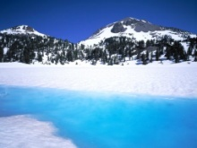
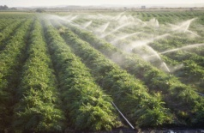

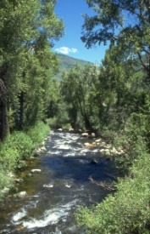
Water Allocation
Basin
Economic values for agricultural, urban and hydropower uses
Constraints for capacity limitations and regulatory requirements
82-year hydrology and operations
Monthly time-step
City A
$
River
Agriculture
$
City B
$
$
Aquifer

Slide 6
CALVIN
Optimization tools from engineering
Ideas from economics
Forces quantitative understanding of integrated water and economic system
Provides insights into regional and statewide water planning and management

Slide 7
Motivation
Make better sense of integrated system and operations
Seek ways to improve system management
Quantifying user willingness to pay for additional water
Find insights into changes in physical capacities and policies

Slide 8
Model Coverage
Most agricultural activities and urban population
Major conveyance systems (CAA, DMC, CRA)
CVP and SWP operations
Surface and groundwater reservoirs

Slide 9
Network-Flow Structure
link
Nodes
Reservoirs, plants, demand areas
Links
Capacity (upper bound), minimum flow (lower bound), loss (amplitude), cost
CALVIN network schematic
i
j
link
origin
node
terminal
node

Slide 10
Water Users: Demand Areas
Users
Agricultural
Urban
Environmental
Economic representation for ag and urban
Penalty for not delivering water
Urban users with higher WTP
Constrained (fixed) deliveries for environment (wildlife refuges)

Slide 11
Demand Area Penalty Curves
Penalty for not delivering water (and economic loss)
No penalty at the target delivery
Piecewise linear curves (linear programming model)
User’s willingness to pay (WTP) for water
Convex: the more delivery the less penalty
Marginal WTP for additional water ($/AF)
Scarcity
Actual penalty
Target
delivery
Actual delivery

Slide 12
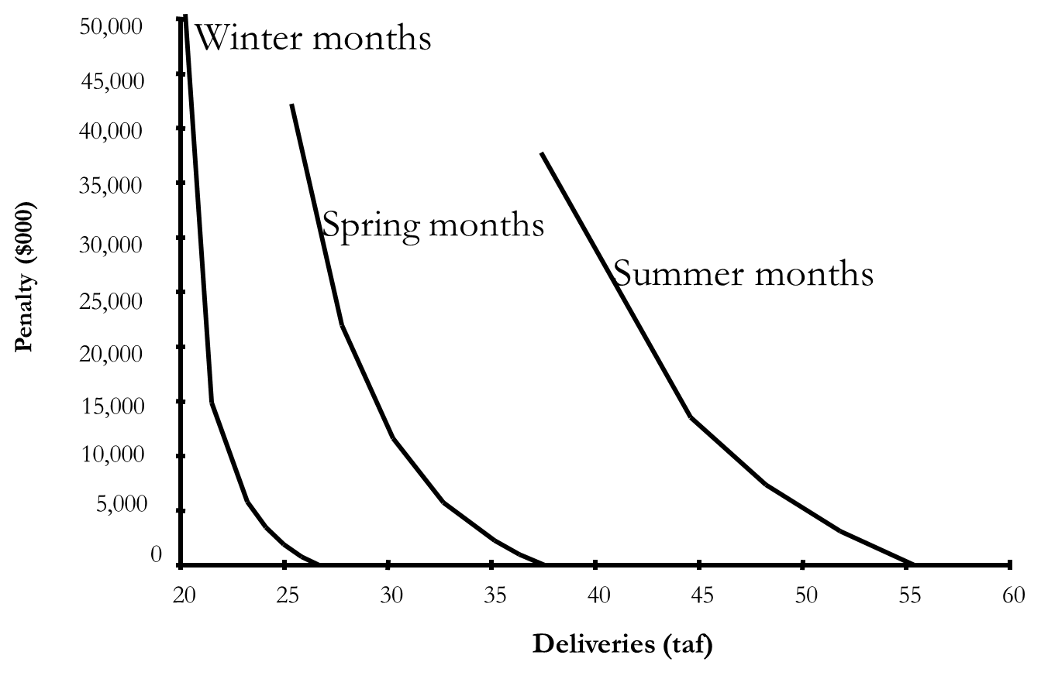
Monthly Varying Demand Curves
Demand curves vary by month (no annual variation)
Higher target demand in summer months
Less price elasticity (steeper slope) in winter months

Slide 13
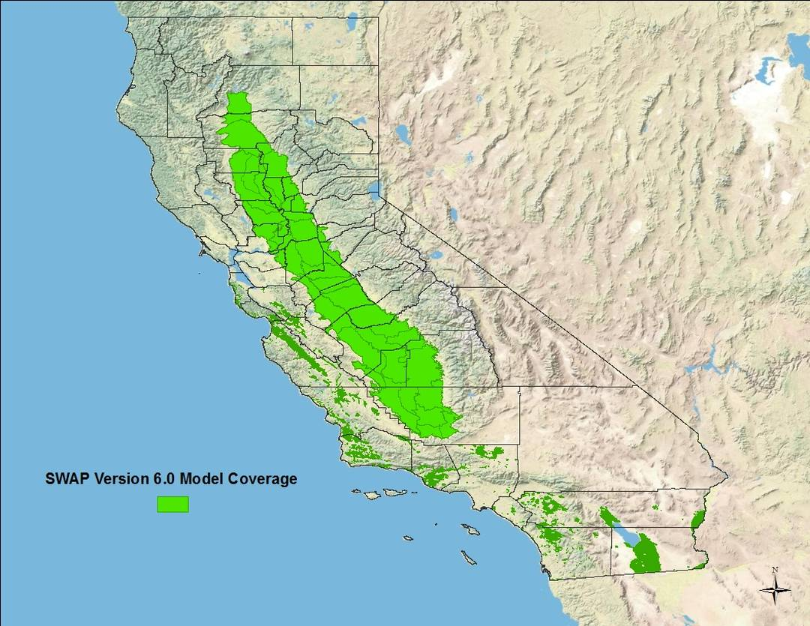
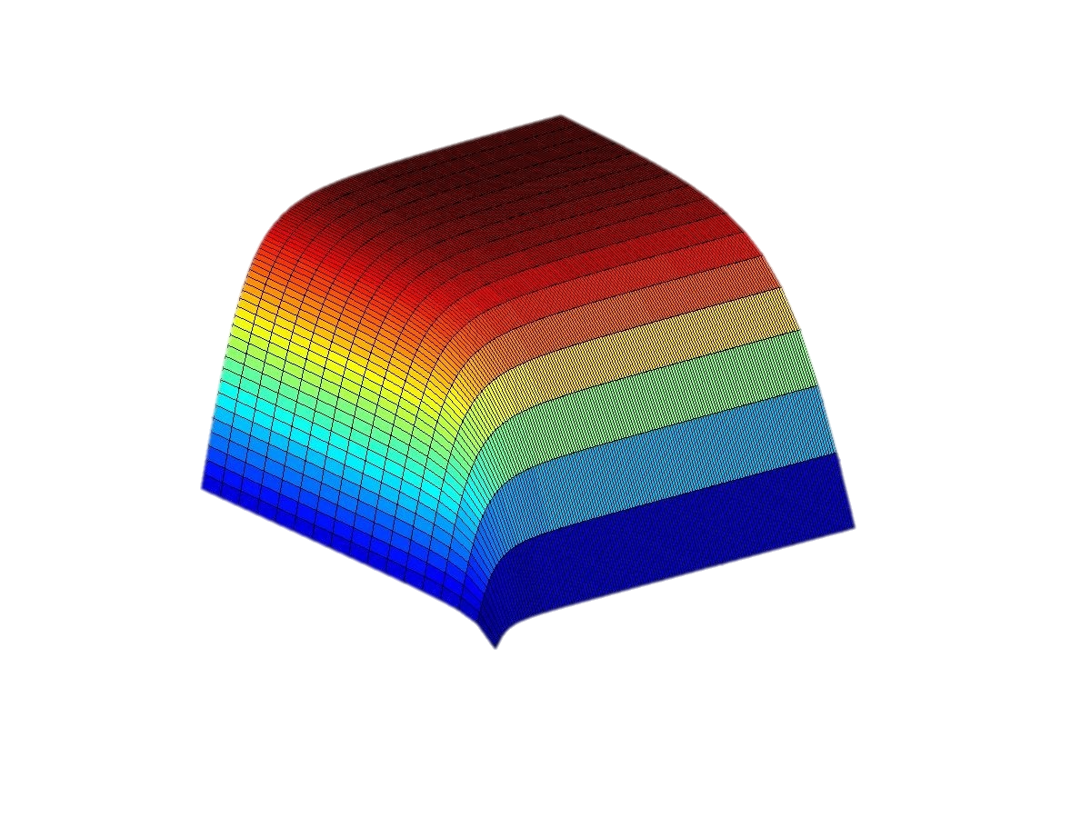
Agricultural Representation
Results from Statewide Agricultural Production (SWAP) model
SWAP simulates farmers decision in California
Profit maximization model
35 aggregated subbasins
SWAP results are used to create ag penalties in CALVIN (& PyVIN)
SWAP Model Coverage
Production
Water
Labor

Slide 14
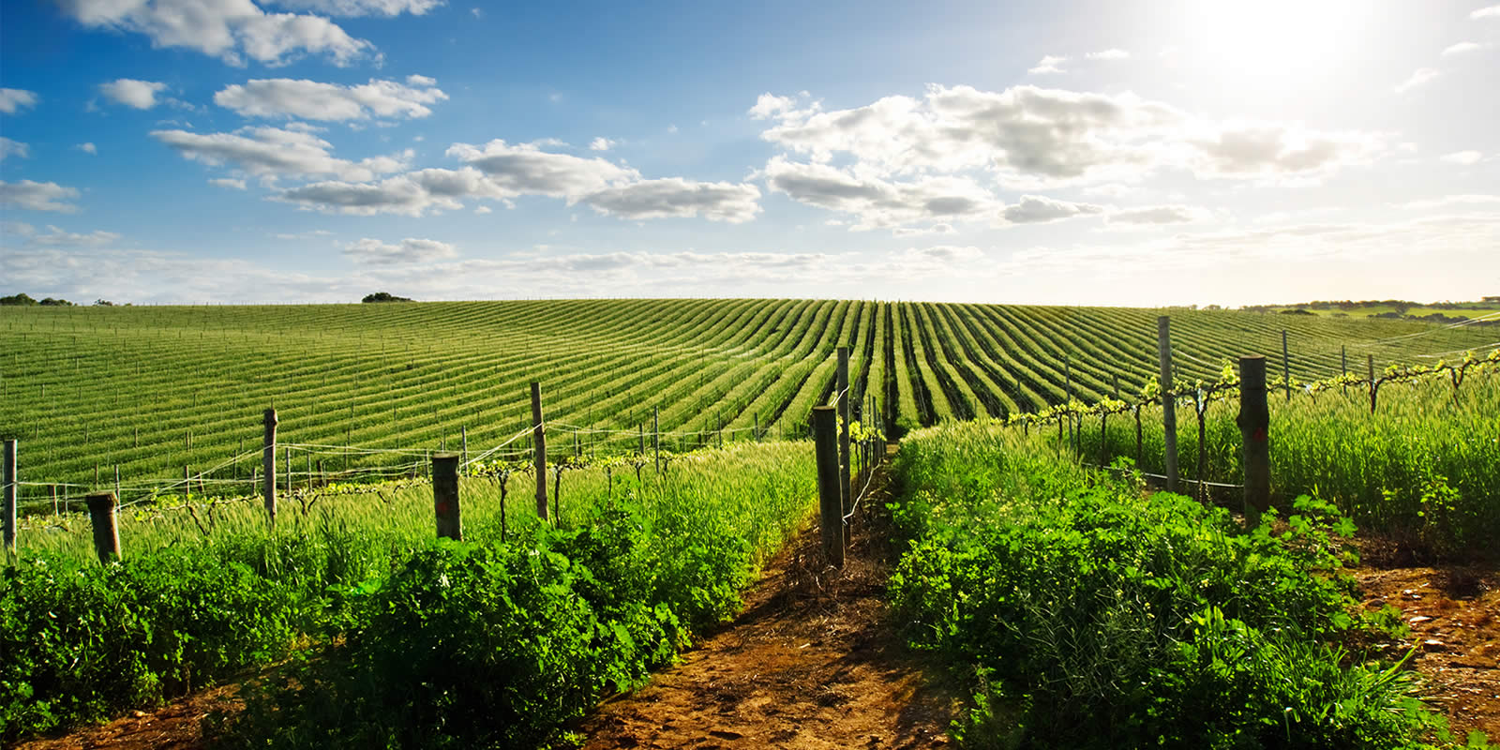
Agricultural Demand
HGP
α, $
Pumping Capacity
Pumping Cost
A < 1
Conveyance Loss
HSU
SW u/s
α, $
Conveyance Capacity
Distribution Cost
Supply sources:
Groundwater
Surface water
Split into two parts depending on return flows
A
groundwater
surface water
A > 1
Ag Reuse
GW
HU
α=UBT, $=TD
Target Delivery
Shortage Penalty
α=UBT, $=TD
Target Delivery
Shortage Penalty
HGR
gw return
surface return
A<1
% GW Return Flow
A<1
% SW Return Flow
HSD
SW d/s

Slide 15
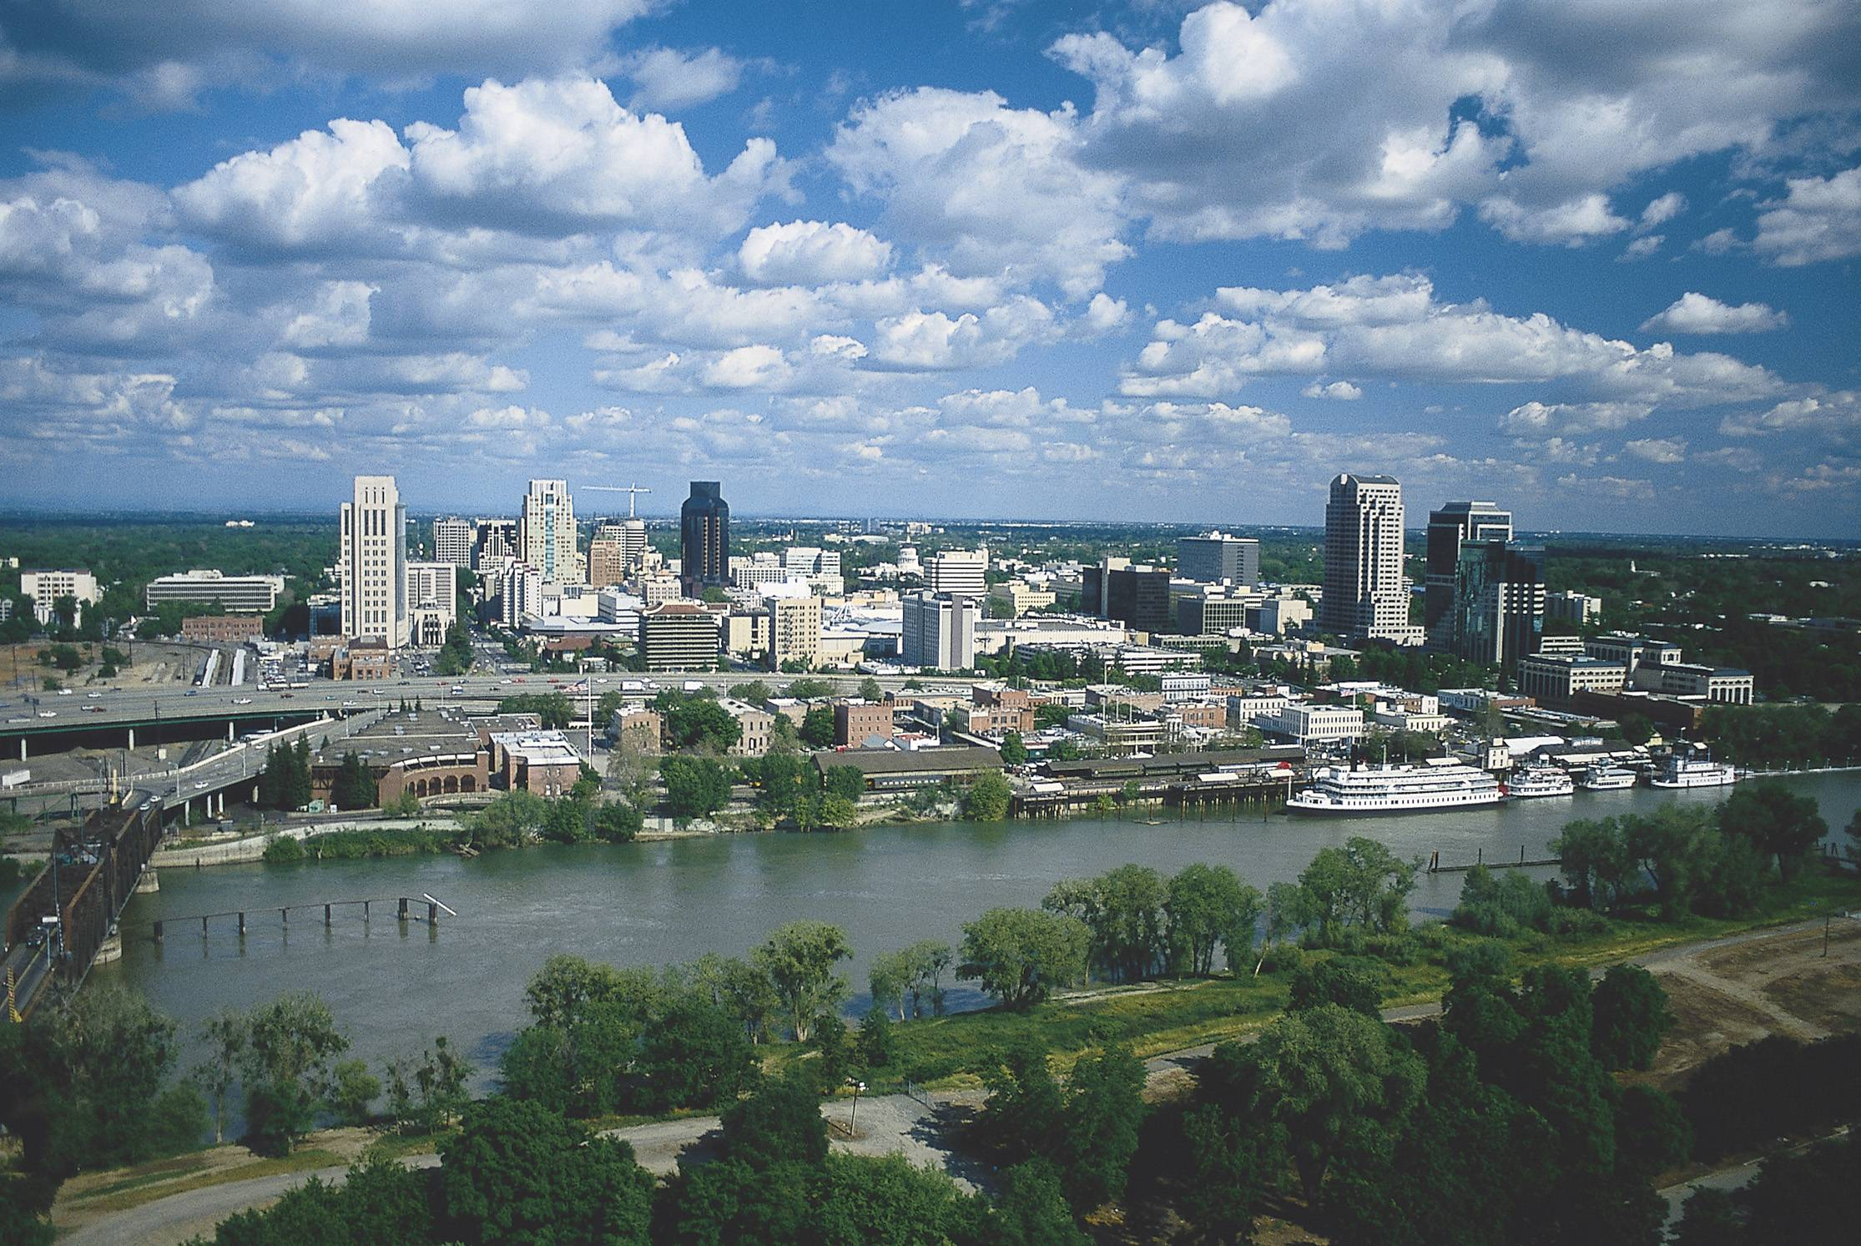
Urban Demand
Desalination
α=N/A, $
WTP capacity
Treatment cost
WTP
α=UBC, $
Canal capacity
Distribution Cost
SW u/s
HGP
α=UBC, $
Pumping capacity
Pumping cost
U
Aggregation Node
Supply sources:
Groundwater
Surface water
Split into three parts
Exterior
Interior
Industrial
GW
HXI
α=UBT, $=TD
Target Delivery Shortage Penalty
α=UBT, $=TD
Target Delivery Shortage Penalty
α=UBT, $=TD
Target Delivery Shortage Penalty
HGR
exterior
HP
A<1
Exterior Urban
Use Return Flow
industrial
interior
α=UBC, $
WWTP capacity
for potable use
Treatment Cost
HNP
A<1
Industrial Urban
Use Return Flow
A<1
Interior Urban
Use Return Flow
α=UBC, $
WWTP capacity
for non-potable use
Treatment Cost
WWP
$
Treatment Cost for discharge into GW basin
$
Treatment Cost for discharge into SW source
SW d/s

Slide 16
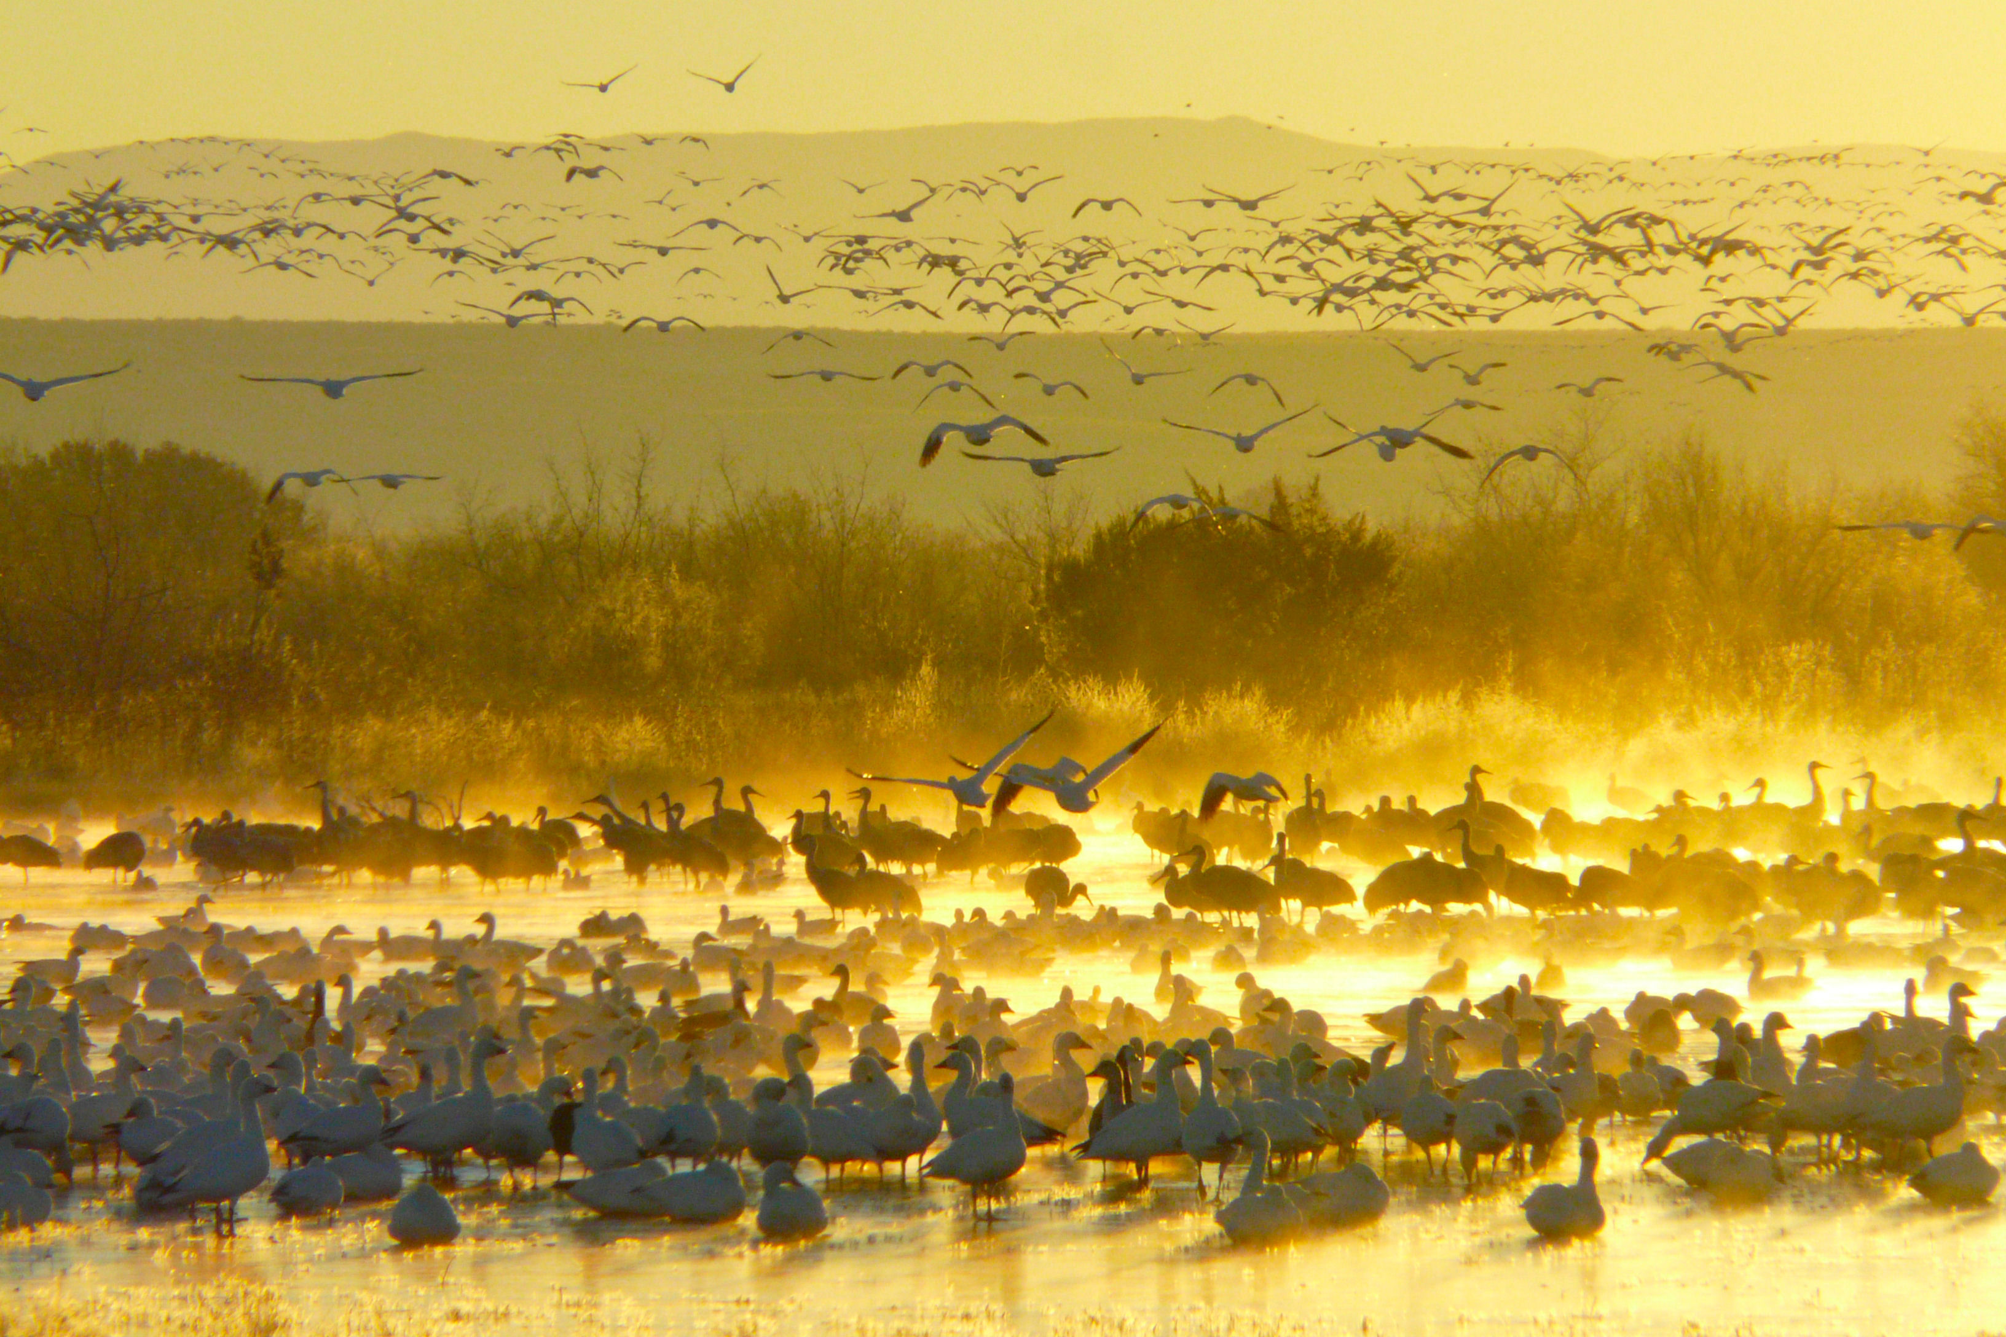
Wildlife Refuge Demand
surface water
groundwater
α
Diversion Capacity
HSR###
A<1
Conveyance Losses
HSU###
Supply sources:
Groundwater
Surface water
Ag return flow
Constrained (fixed) flow deliveries
HGP##
α, $
Pumping Capacity & Cost
R###
α
Ag Return Flow Diversion Capacity
A>1
Reuse Capability
HSD###
GW ##
ag return flow
HSUR###
α=EQC
Refuge Target Demand
A<1
Return Flow
d/s
Wildlife Refuge

Slide 17
Advantages
Limitations
Integrated model (surface and groundwater)
Unique combination of economics and engineering principles
Well-documented model (reports, articles, website and theses)
Perfect hydrologic foresight
The model knows all hydrologic events in its operating period
Scarcity costs are less than actual
Simplified reservoir and Delta operations
Piecewise linearization
Simplified hydropower representation

Slide 18
HOBBES Database

Slide 19
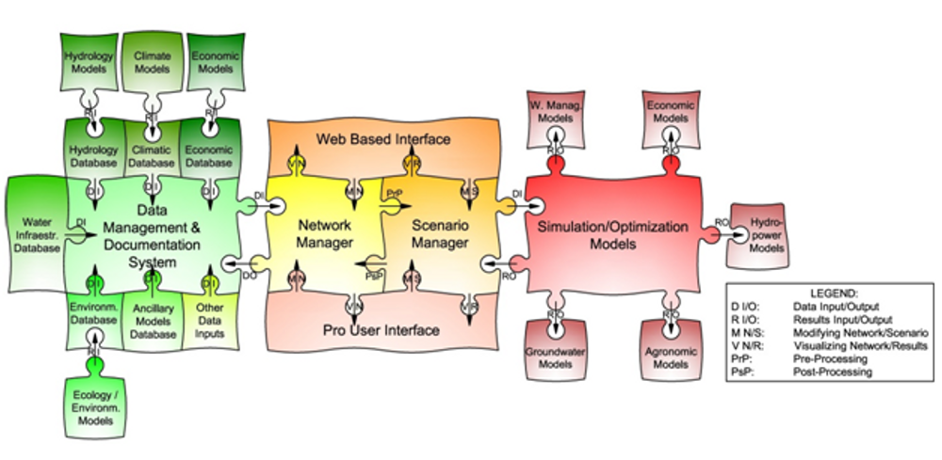
HOBBES
A bottom up approach to improve and organize data
Venue for modelers to create an open, organized and documented water representation
Geocoded elements can be converted to networks and solved by multiple modeling platforms (PyVIN)

Slide 20
Modeling with HOBBES
Online Database
Version Control
Data Visualization
Documentation
Collaboration
Classical Approach
1
model
HOBBES
CALVIN
PyVIN
Other Models
2
data
2
data
1
data
2
model
3
model
model

Slide 21
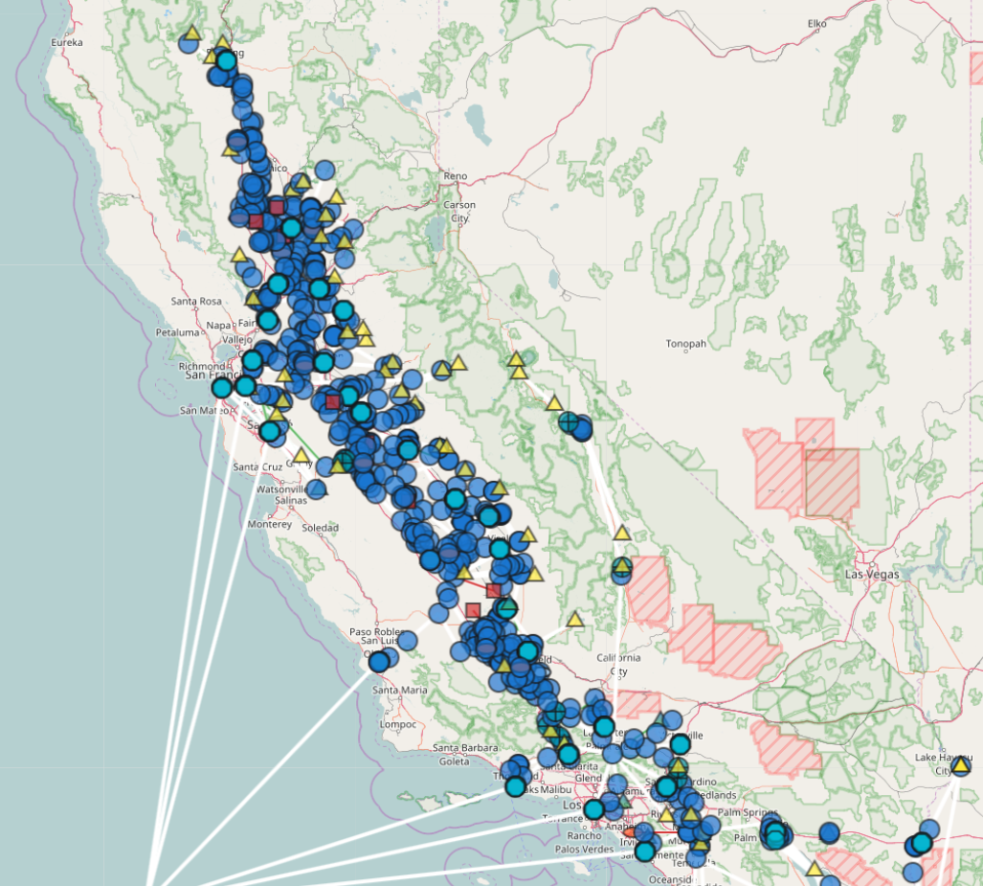
HOBBES Website
https://cwn.casil.ucdavis.edu
California water network
Geocoded network elements
Layered based on hydrologic regions and subregions
Data visualization
Animation tool

Slide 22
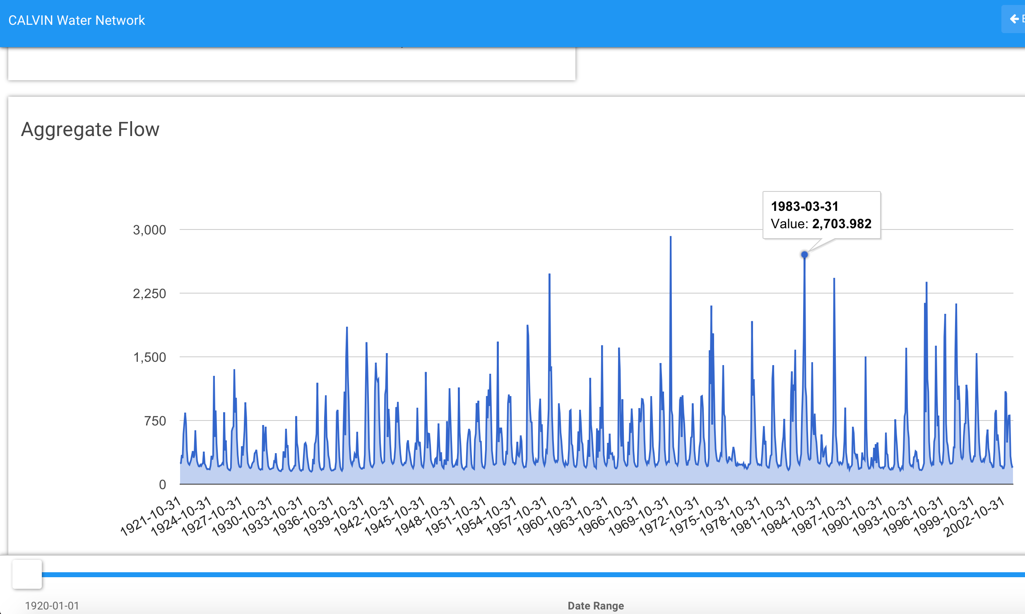
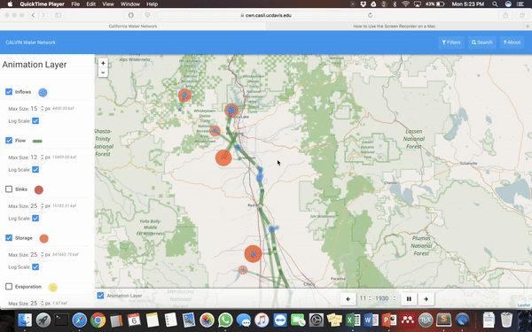
Data Visualization
Animation tool
Inflow, flow, storage, evaporation
Graph flow and storage results
Select time-period

Slide 23
Data Flow Overview

Slide 24
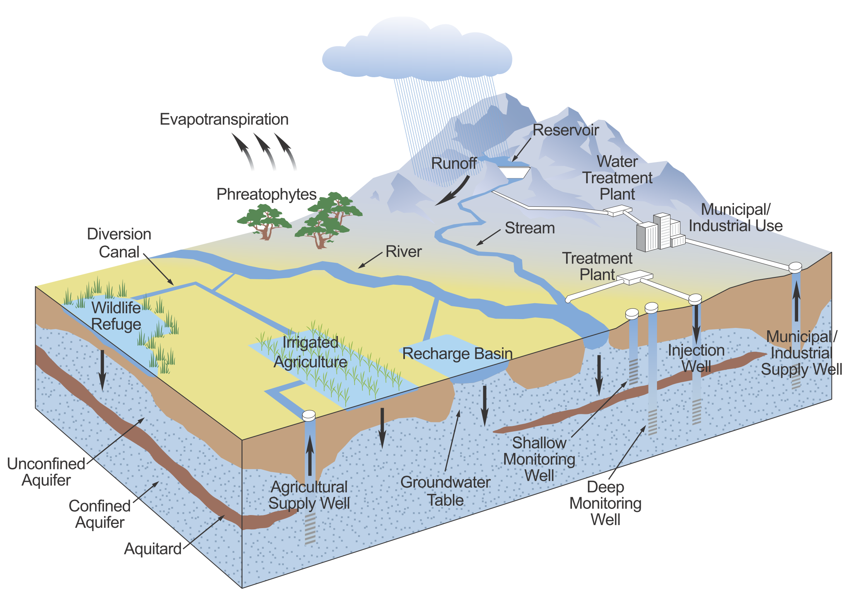
Hydrology
SEEPAGE/ EVAPORATION LOSSES
RIM INFLOWS (CalSim II)
NET RESERVOIR EVAPORATION (CalSim II)
LOCAL ACCRETIONS/ DEPLETIONS (CalSim II)
Image: California Water Plan Update 2013
GW INFLOWS (C2VSim)

Slide 25
Operating Cost
HYDROPOWER BENEFITS
ARTIFICIAL RECHARGE OPERATION COST
WATER TREATMENT COST
Image: California Water Plan Update 2013
PUMPING COST

Slide 26
PyVIN Model

Slide 27
Goals
data transparency
collaboration
run speed
version control
documentation

Slide 28
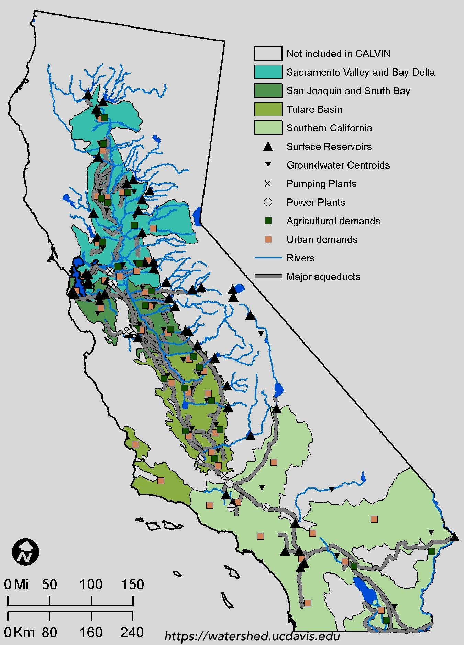
CALVIN
HOBBES Database
~1250 nodes
~600 conveyance links
49 surface reservoirs
38 groundwater reservoirs
88% of CA’s irrigated acreage
92% of CA’s urban population
https://cwn.casil.ucdavis.edu

Slide 29


Modeling Environment
Pyomo is a Python-based, open-source optimization modeling language
Algebraic language similar to GAMS, AMPL
Easy to install: ”conda install -c cachemeorg pyomo”
User defined solvers:
CPLEX¹
GUROBI¹
CBC²
GLPK²
(¹ free for academic purposes only, ² open source)
http://www.pyomo.org/documentation

Slide 30

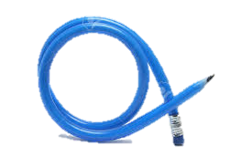



CALVIN v.1 | PyVIN v.2
Large-scale hydroeconomic model
Optimize water allocation to agricultural and urban users
Minimize statewide water scarcity and operating costs
HEC-PRM and VBA based | Pyomo and Python based
Less flexible (limited to HEC-PRM) | More flexible (full LP)
Solver runtime: ~16 hr (depending on initial solution) | Solver runtime: ~1 min (depending on solver)
Requires 32 bit Windows PC | Any computer
HEC-DSS database | Open source: data and source code

Slide 31

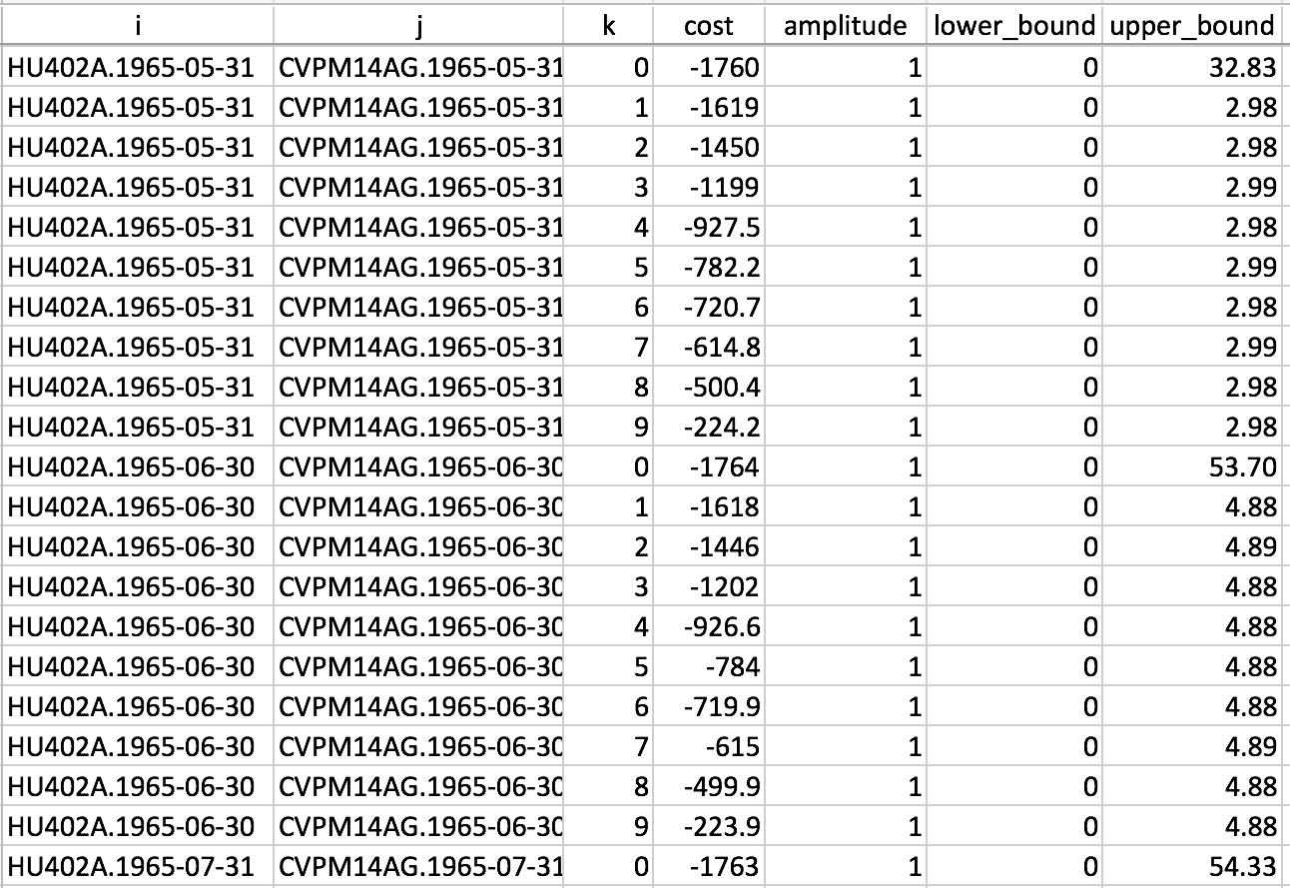
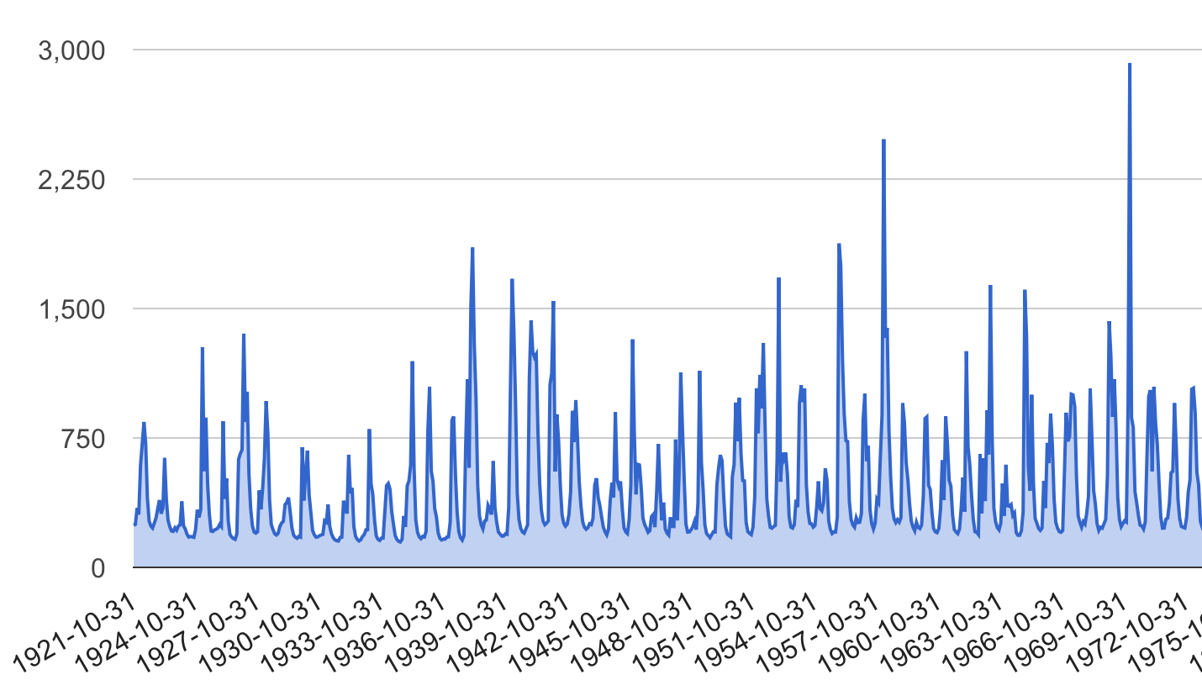

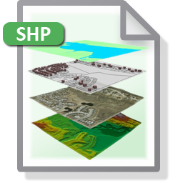
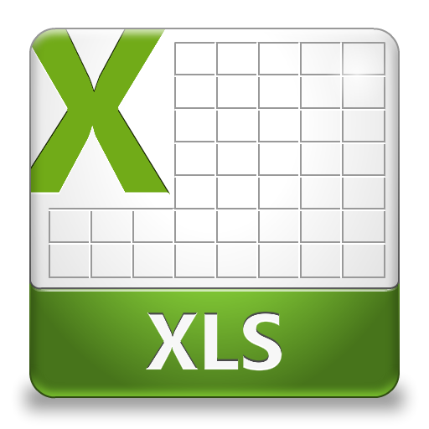
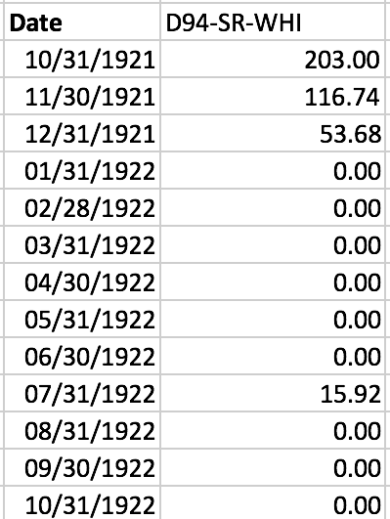

HOBBES Matrix Creator
Calvin (2015)
Data Matrix (PyVIN input)
Time-series
Calvin (2014)
Calvin (2015)
Calvin (2015)
Calvin (2015)
Errata (2014-2015)
extra
hydrograph
Demand Curves
+
Price ($/Vol)
Calvin (2015)
p*
Calvin (2015)
Q (volume)
Calvin (2015)
Q* (objective)
Calvin (2015)
Calvin (2015)
Calvin (2015)

Slide 32
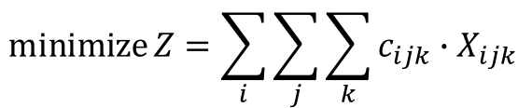
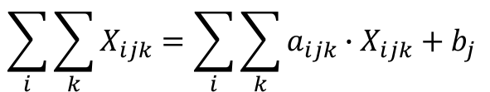
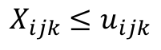
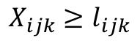
PyVIN Model Structure
1
Linear Programming Model with Gains & Losses
objective
$$\operatorname{minimize}{Z}=\sum_{i}{\sum_{j}{\sum_{k}{c_{ijk}∙X_{ijk}}}}$$
where
Z: total cost
X: flow on the arc
c: unit cost (or penalty)
b: external flow
a: amplitude
l: lower bound
u: upper bound
mass balance
$$\sum_{i}{\sum_{k}{X_{ijk}=\sum_{i}{\sum_{k}{a_{ijk}∙X_{ijk}+b_{j}}}}}$$
3
Freely Available Solvers
upper bound
CPLEX
CBC
GUROBI
GLPK
$$X_{ijk}≤u_{ijk}$$
lower bound
$$X_{ijk}≥l_{ijk}$$
2
Abstract Model in Pyomo
User installed and defined solvers
No dependency on any solver
Model Structure
Data
PyVIN
Separate data and model structure

Slide 33
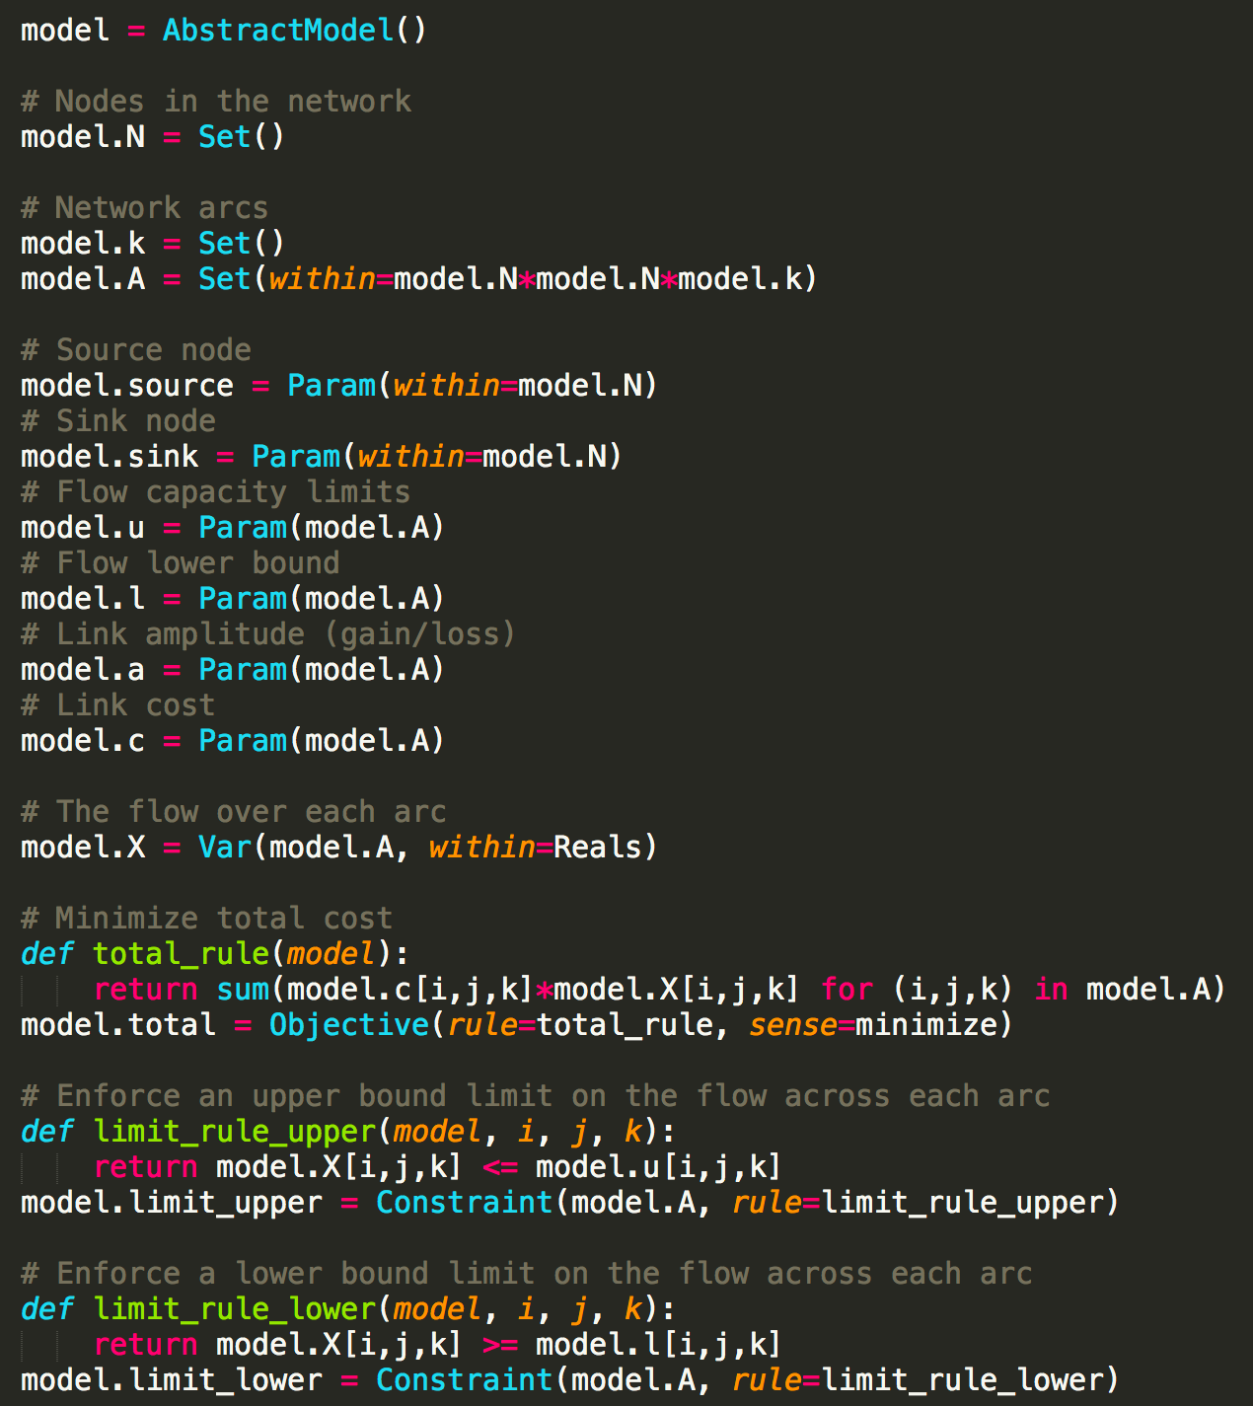
PyVIN Run Process
HOBBES
Input Data
Network matrix
Pyomo
Model Run
Specify data file and solver
Python
Postprocess Results
Analyze results stored in *.csv files
HOBBES
Data Visualization
Time-series plots & animation

Slide 34
PyVIN
Input
Output
flow.csv
storage.csv
shortage cost.csv
dual - lower bound.csv
dual - upper bound.csv
benefits of capacity expansion
water deliveries to users
surface and groundwater storage
cost of shortage to users and WTP for additional water
shadow prices of environmental flows
pyvin.py
data.dat

Slide 35
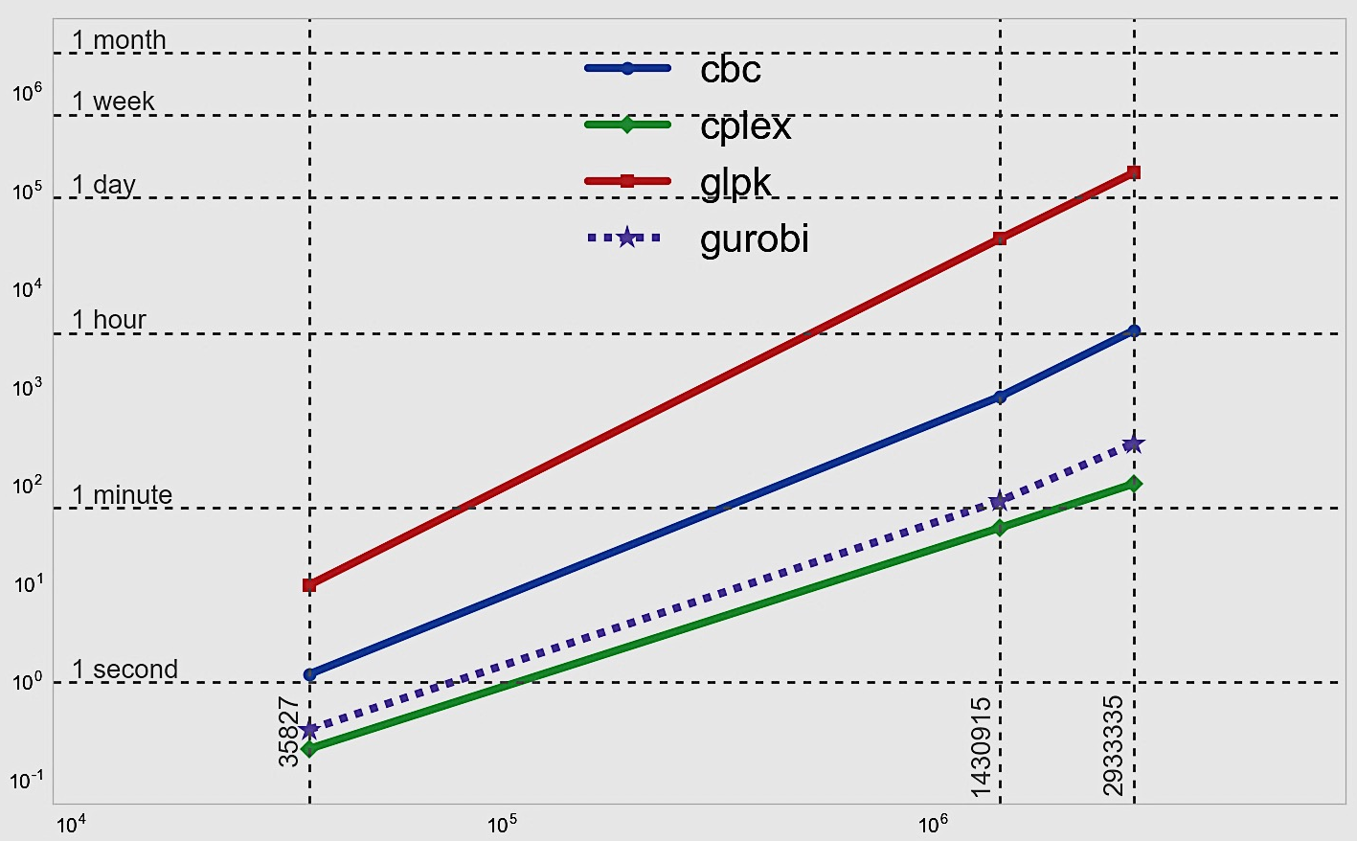
Solver Time
glpk
Y=(9.83E-10)X^{2.19551}
Runs are performed on UC Davis College of Engineering’s HPC1 (High Performance Computer)
cbc, cplex and gurobi are run in parallel, and glpk is run in serial
cbc
Y=(5.59E-09)X^{1.83019}
open source
gurobi
Y=(3.77E-08)X^{1.52444}
time (second)
cplex
Y=(7.84E-08)X^{1.41141}
~35K
~3M
~1.4M
number of decision variables

Slide 36
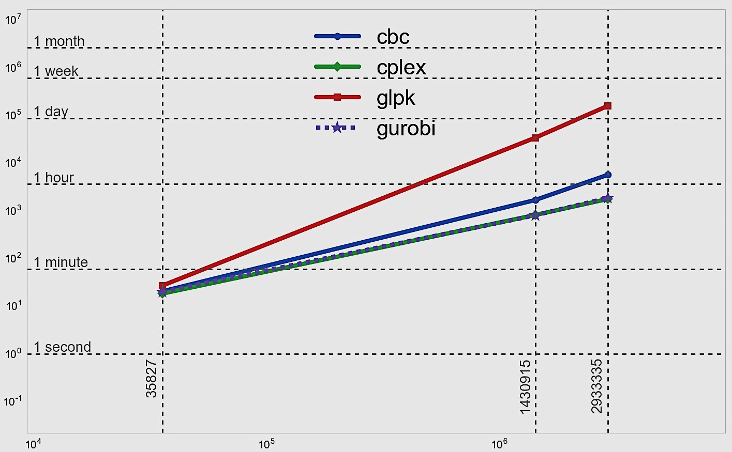
Total Runtime
Pyomo builds the model
Solver finds a solution
Pyomo writes results
glpk
Y=(2.88E-08)X^{1.96947}
Differences get bigger as model size increases
cplex and gurobi have similar total runtime
cbc
Y=(3.11E-05)X^{1.27684}
gurobi
Y=(4.13E-04)X^{1.02861}
time (second)
~35K
cplex
Y=(3.46E-04)X^{1.03667}
~3M
~1.4M
# of decision variables | output file size (json)
35,827 | ~7.5 MB
1,430,915 | ~300 MB
2,933,335 | ~602 MB
number of decision variables

Slide 37
Solver Accuracy
Solver Result Comparison
model size
gurobi
~35K
Objective value normalized to glpk results
cbc results slightly lower
Overall consistent solver results
cplex
glpk
cbc
Normalized to glpk (%)
cplex
gurobi
~1.4M
glpk
cbc
cplex
gurobi
~3M
glpk
cbc
solvers

Slide 38
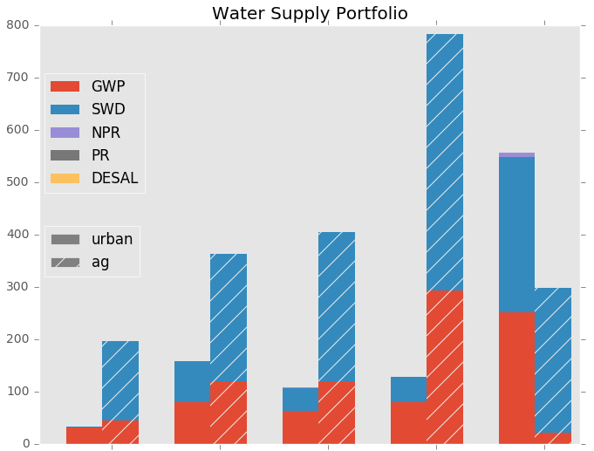
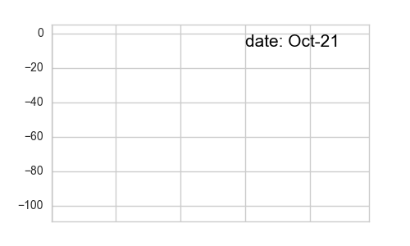
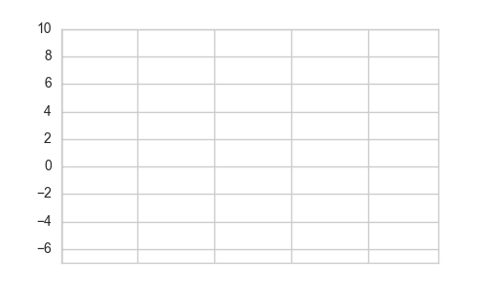
Preliminary Results
Monthly Change in Overall Storage (MAF)
ΔGroundwater
Urban Delivery
Monthly Avg. Delivery (TAF/m)
Groundwater
Oct-1921
Sep-2003
Agricultural Delivery
Surface water
ΔSurface water
Upper Sacramento
Lower Sacramento
& Delta
San Joaquin
& South Bay
Tulare Basin
Southern California
Oct-1921
Sep-2003

Slide 39
Limitations & Improvements
Perfect foresight
Run year-by-year to prevent perfect hydrologic foresight
Groundwater representation
Implement SGMA constraints on groundwater basins
Water rights
Represent water rights in system operations

Slide 40
Software Installation & Your 1st PyVIN run

Slide 43
Postprocessing Results

